Slide 1


GROUP 3
with
CHOICE FOUNDATION

Slide 2
AUTISM IN INDIA PREVAILS FOR 1 IN 68 STUDENTS
AUTISM CURRENTLY AFFECTS 18 MILLION PEOPLE IN INDIA

Slide 3
CHOICE FOUNDATION
9000+ Students screened under My Child Health program.
300+ Children helped in critical illness.
Multiple Completed, Ongoing and Upcoming Projects for the society

Slide 4


A TYPICAL SCENARIO
HEAD
ANALYSIS
STUDENT
MOVEMENT
ANALYSIS
TIME CONSUMING
MORE RESOURCES
PRONE TO BOTTLENECKS
CONFUSION, HARDER TO KEEP TRACK
SPEECH
ANALYSIS

Slide 5


OUR PLATFORM
OUR
MODEL
STUDENT
VOLUNTEER
NO MORE
POST SCREENING ANALYSIS
TIME CONSUMING
MORE RESOURCES
PRONE TO BOTTLENECKS

Slide 6
HOW DOES OUR PLATFORM HELP?

Slide 7

GAIT AND BEHAVIOR-BASED AUTISM SCREENING TOOL FOR EARLY DETECTION AND FOLLOW-UP CARE
Aiding Early Detection of Autism
Better Accessibility of Resources
Consistent Tracking and Patient Records
Scalable System
WHAT PERTAINS OUR PROJECT

Slide 8

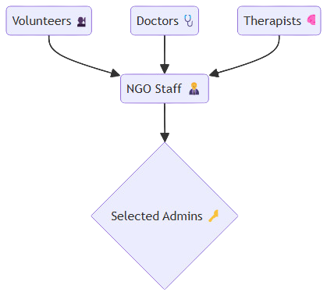
USERS

Slide 9

COMPLETE
SYSTEM
OVERVIEW

Slide 10

Volunteer >

Slide 11
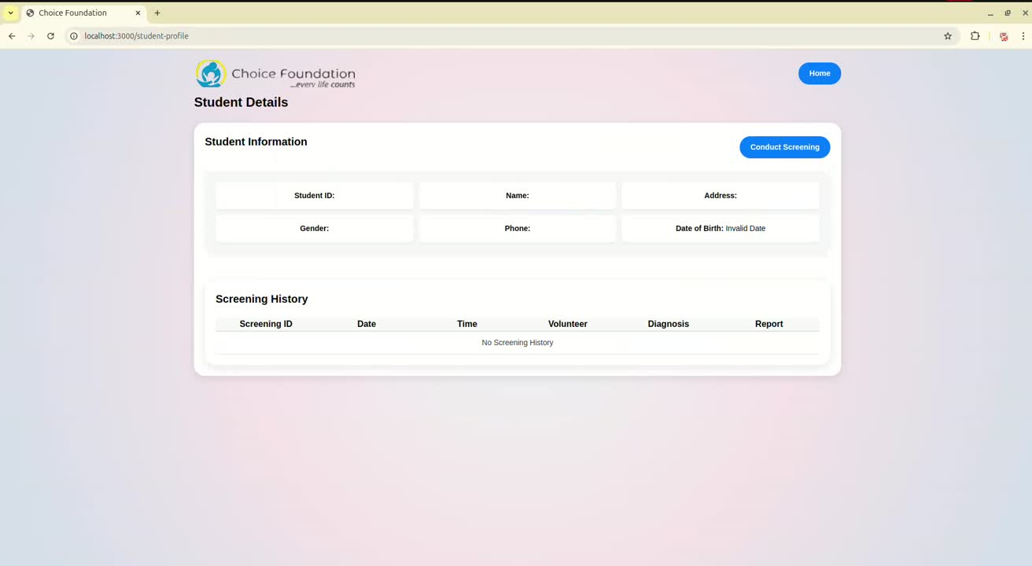

Slide 12
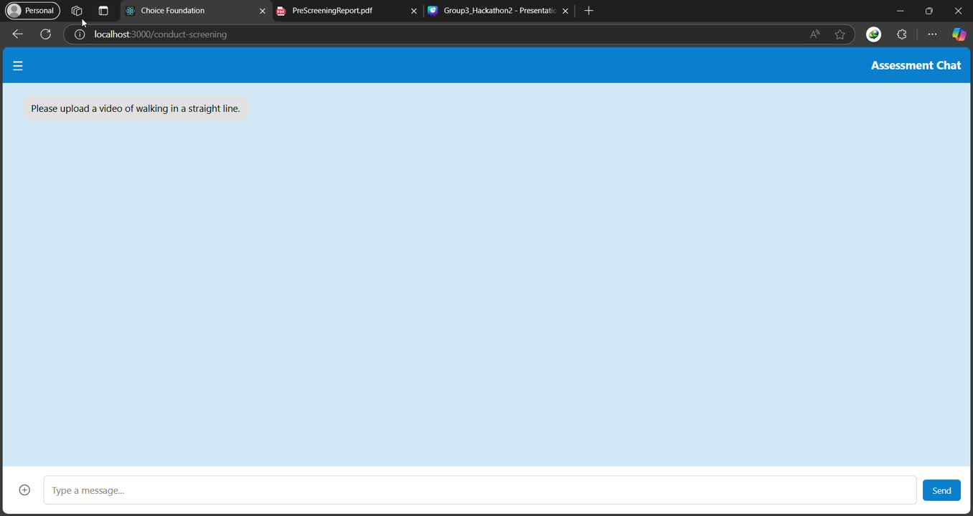

Slide 13
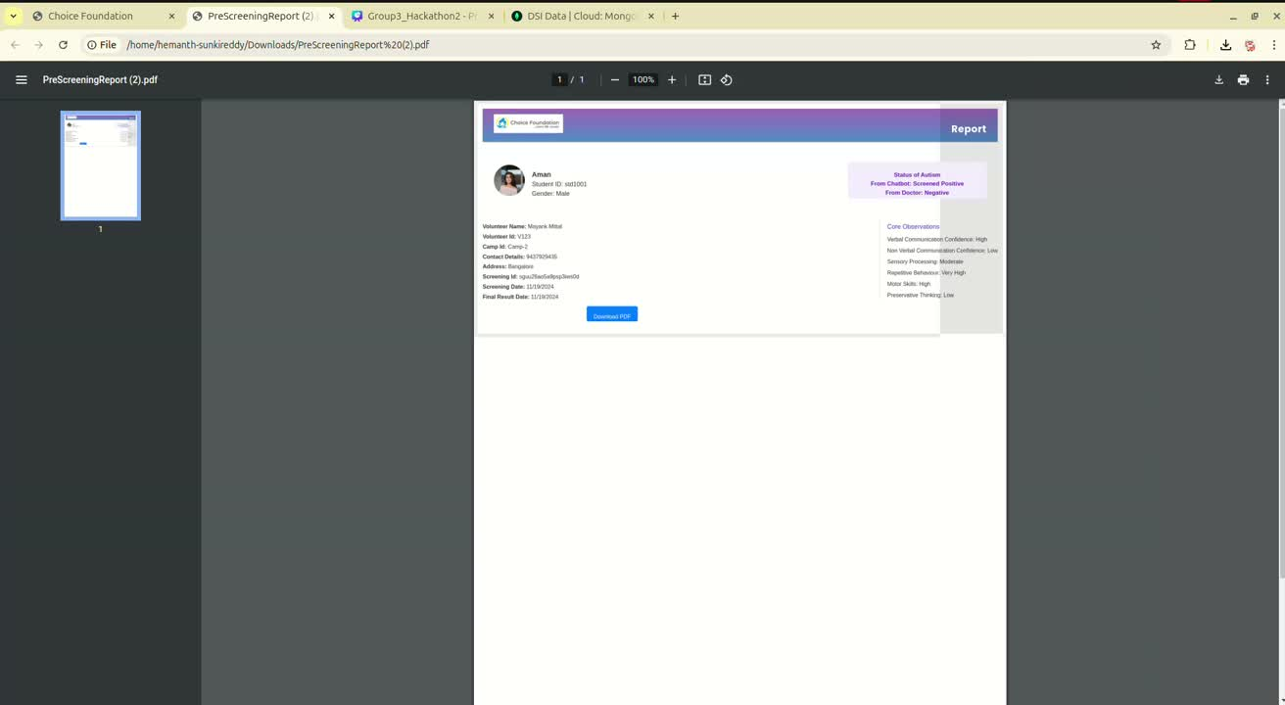

Slide 14
Changing Test >

Slide 15
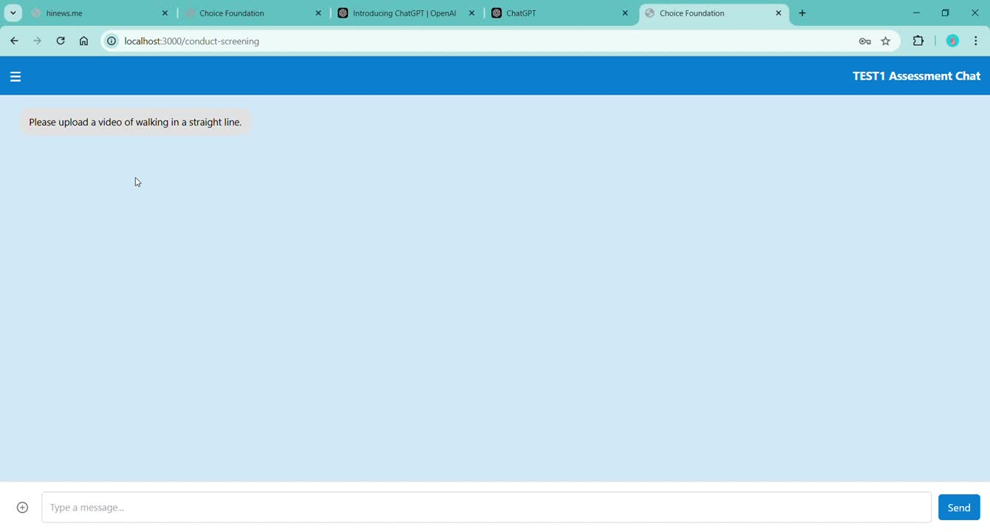
Notes:
Required Video Change

Slide 16
NGO Staff >

Slide 17
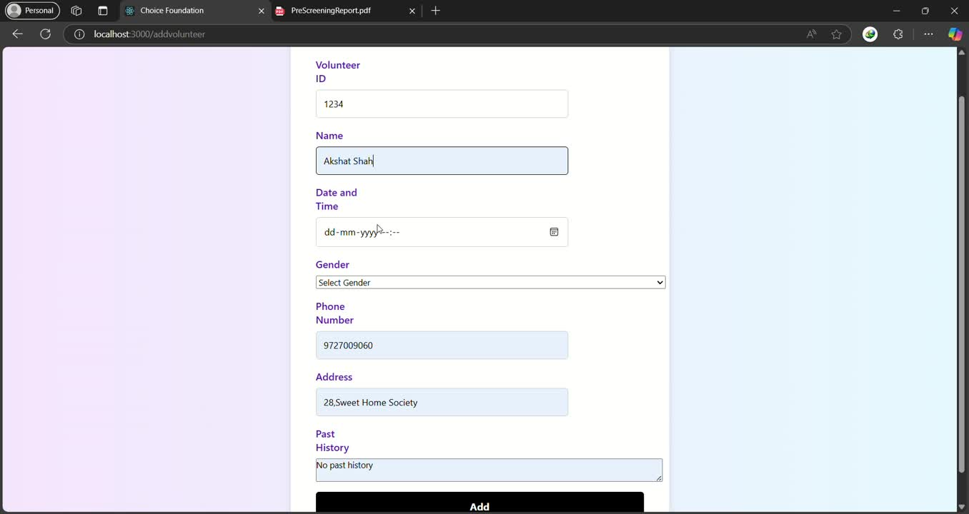

Slide 18
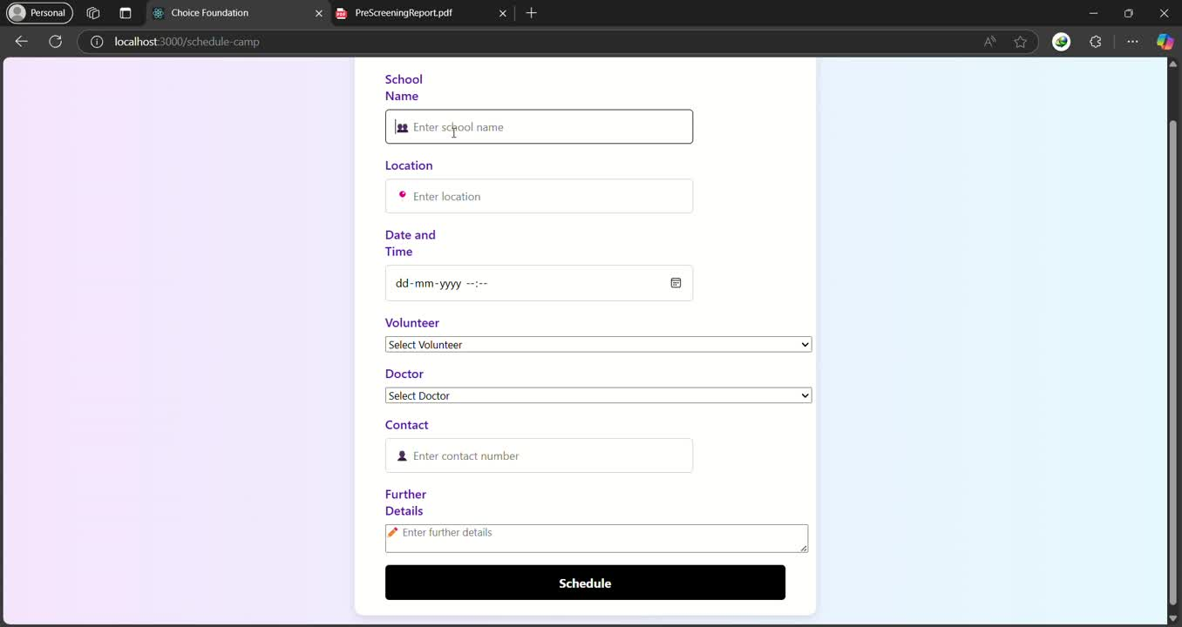
Notes:
Required Change

Slide 19
Doctor >

Slide 20
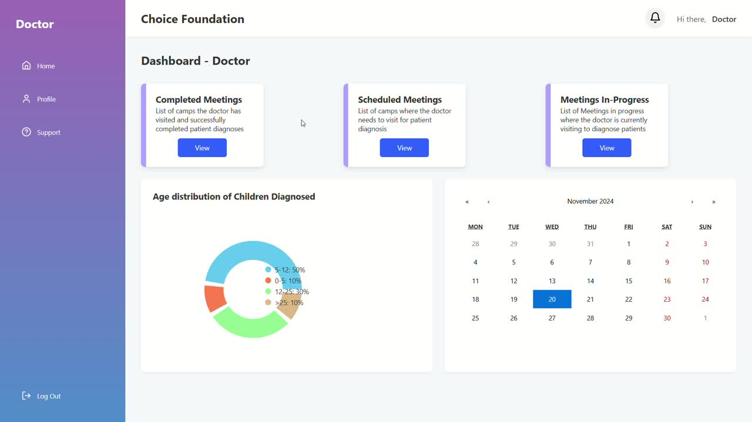

Slide 21
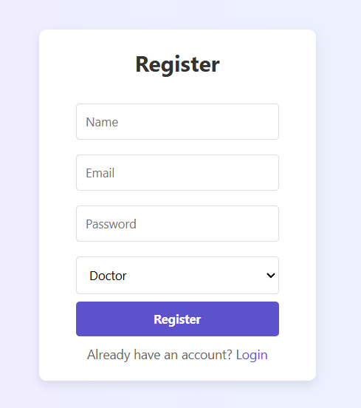
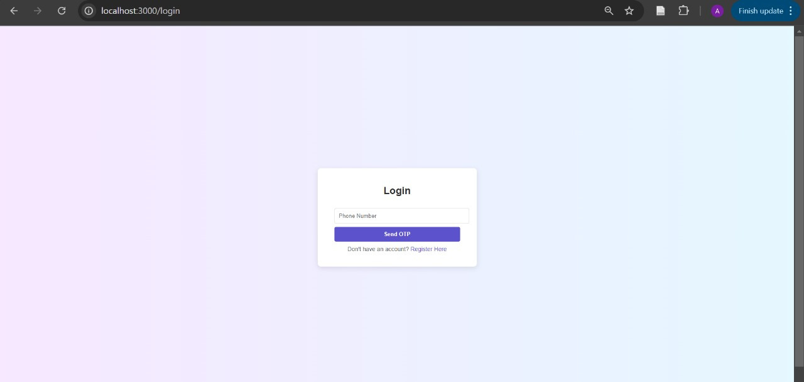
LOGIN/REGISTRATION

Slide 22
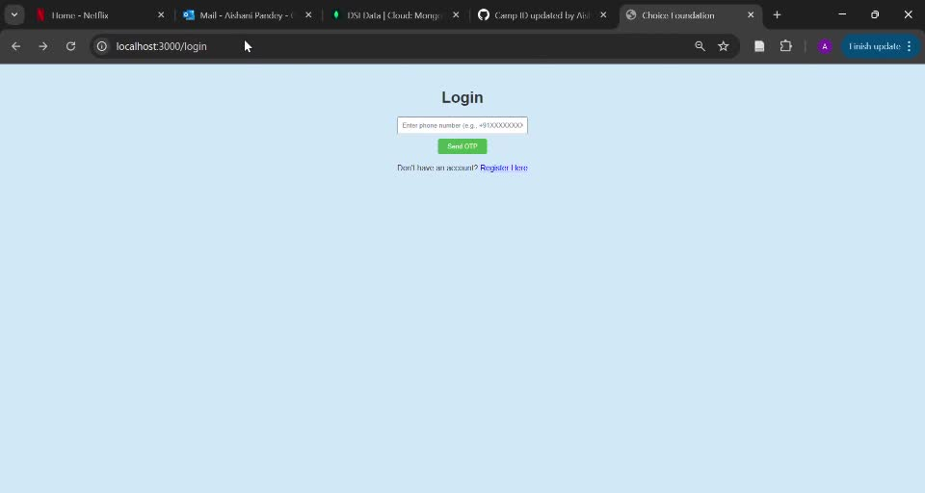
ADMIN APPROVAL
Notes:
Need Change

Slide 23
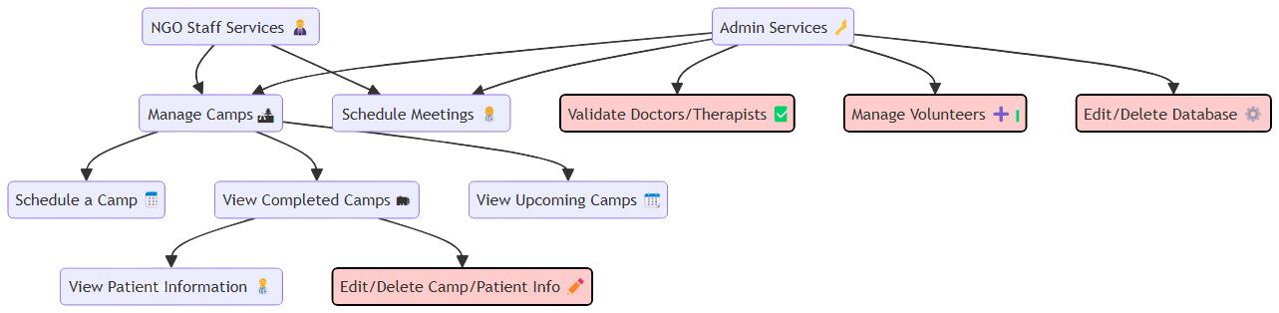
NGO STAFF - ADMIN FUNCTIONALITIES

Slide 24
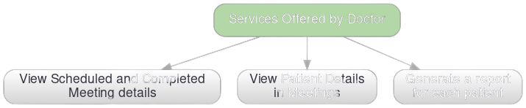
DOCTOR FUNCTIONALITIES

Slide 25
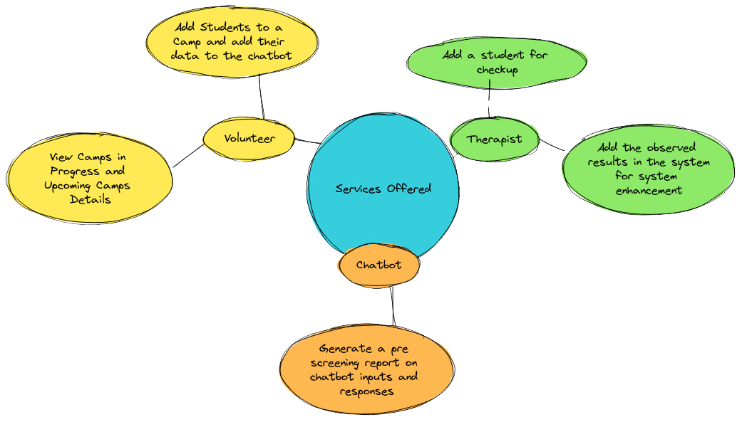
VOLUNTEER-THERAPIST-CHATBOT FUNCTIONALITIES

Slide 26
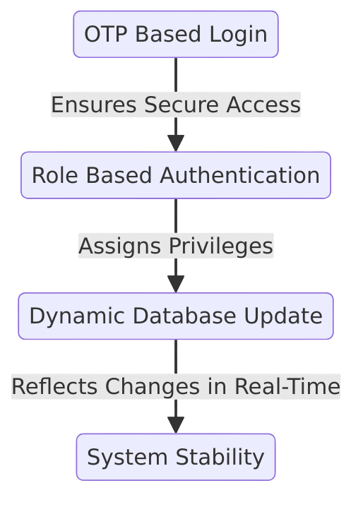
SALIENT FEATURES OF THE SYSTEM

Slide 27


THANK YOU

